Slide 1

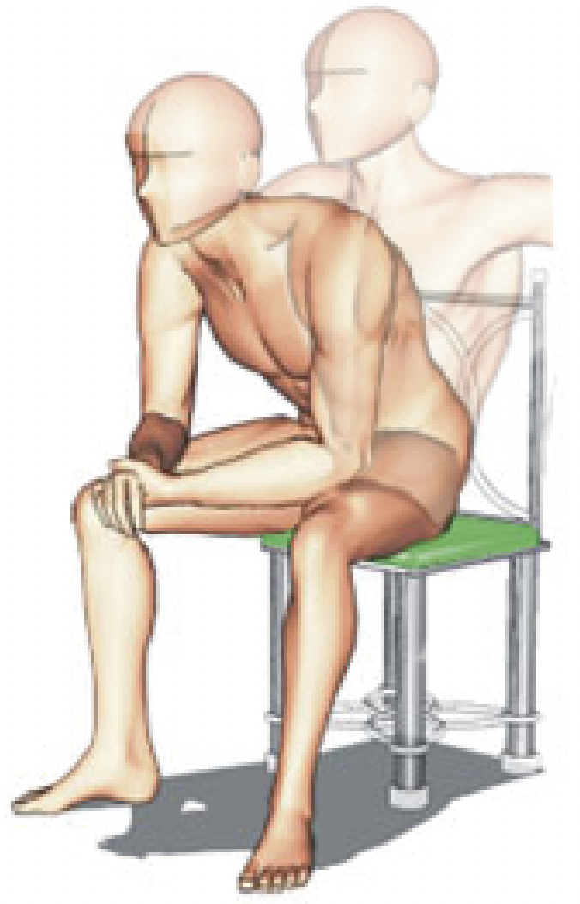
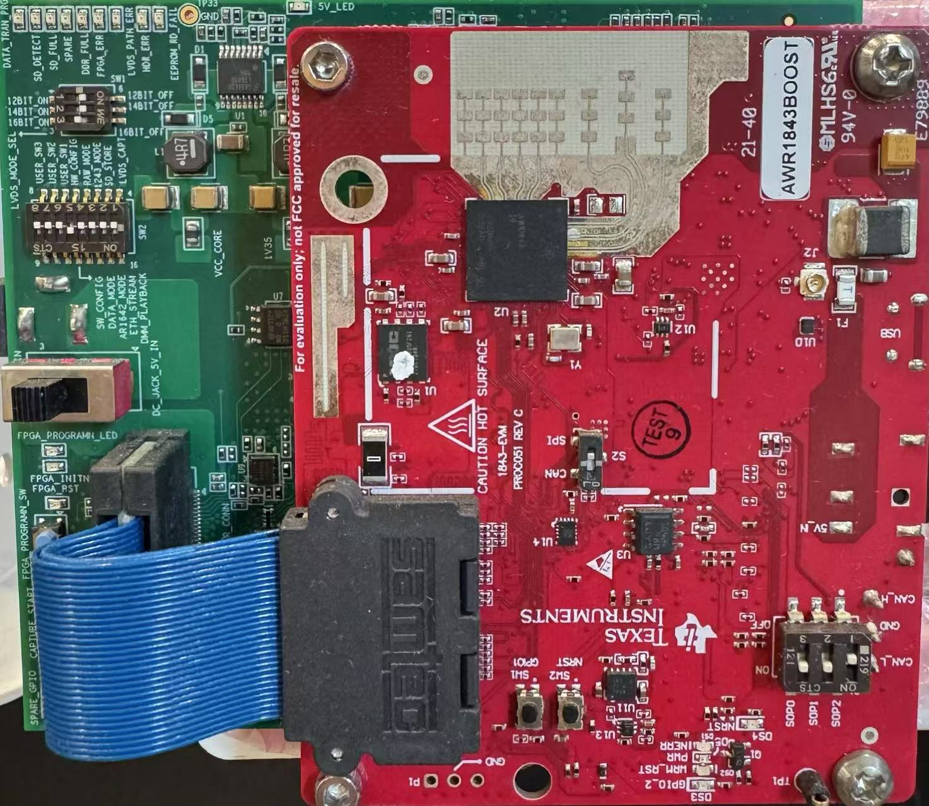
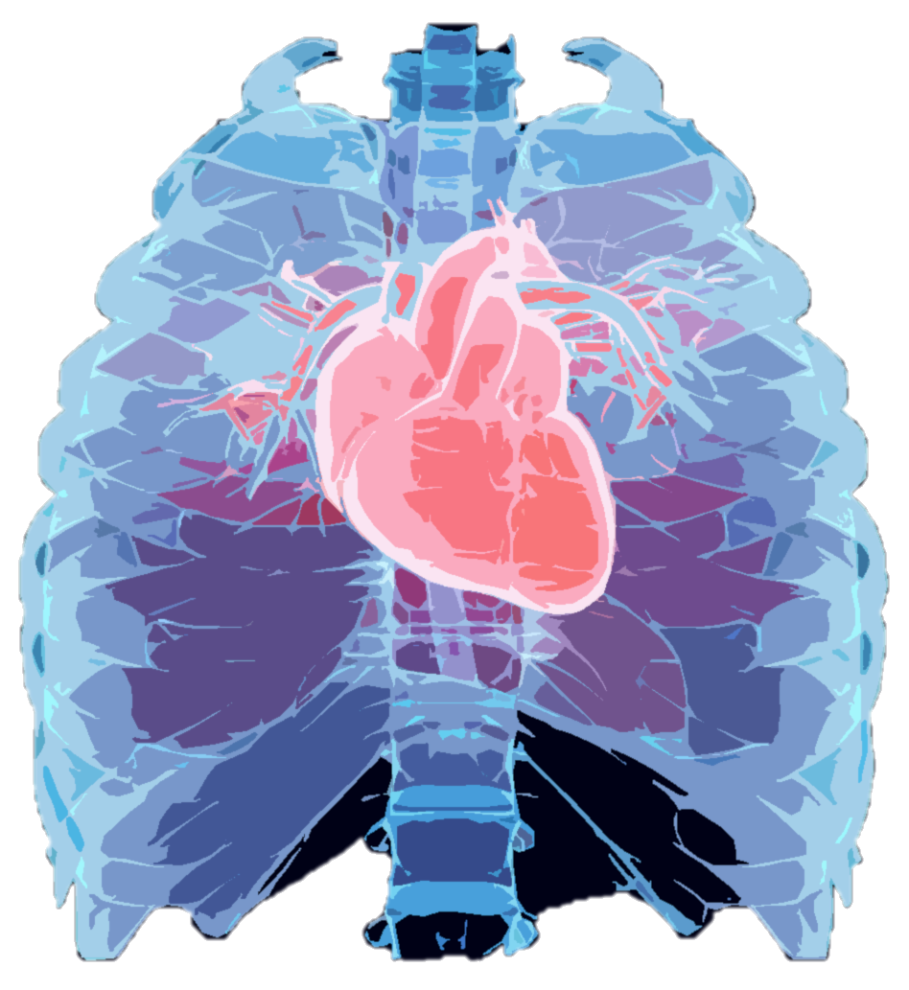
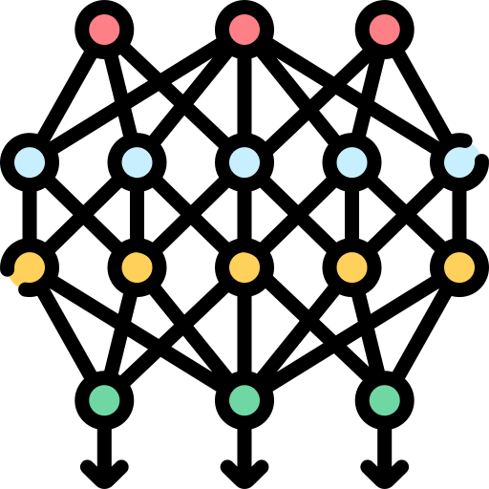
(a) Rough Localization
ECG Monitor
Data Matrix
FFT
Chirps
Ch. 8
…
Ch. 2
Virtual Antennas
TI-AWR 1843
77-81GHz with Tx2Rx4
Subject with Random Body Position
Ch. 1
Frames
Object Detection
Provide Initial State for CFT
(c) Deep Learning Model
(b) Cardio-Focusing and -Tracking (CFT) Algorithm
Convert to Spectrogram
Low-SNR Signals
DFO
DNN
0.4m
0.2m
0.4m
Search for Cardio-Focused (CF) point
Search Space
High-SNR Signals
ECG Outputs
Notes:
Already graduated and will get the degree in November

